Slide 1
15
Session 15 of 24
Classification: yes or no questions
How do we predict a category, and what does the model's confidence mean?
Jotham Martin Wambi, KLAi Professional Learning
Session 15 Classification: yes or no questions
1
Notes:
Last session you built a first model for loan default. Today's question is sharper. How confident is the model, and what do we do with that confidence? You'll fit two kinds of model on the Nile Microfinance loans, learn to read what they say, and choose a cutoff using the cost of a mistake. That last part is where data science meets a manager's budget. By the end you'll have both models, a tree you can read, and a threshold you can defend.

Slide 2
By the end of today
How the two hours run
Fit logistic regression and a decision tree.
Recall and warm-up
10 min
Read predicted probabilities.
Concepts and explanation
30 min
Live demonstration
25 min
Choose a threshold from costs.
Break
5 min
Guided lab
40 min
Check and wrap-up
10 min
Session 15 Classification: yes or no questions
2
Notes:
You'll fit a logistic regression and a decision tree, and read the probabilities they give. You'll turn text columns such as occupation into numbers a model can use. And you'll choose a threshold from the cost of a missed default, working out the cheapest one with a short table. The live part fits both models in the middle, and the costing comes last, which is the order the lab follows too.

Slide 3
Vocabulary
Word | Plain meaning | In a spreadsheet
Classification | Predicting which category a case belongs to, such as default or repaid. | A Yes or No column you want to fill in
Predicted probability | The model's chance, from 0 to 1, that a case is a yes. | A percentage beside each row
Sigmoid curve | The S shaped curve that squeezes any score into a number between 0 and 1. | A trendline bent to stay between 0 and 100 percent
Logistic regression | A model that builds a score from a line, then bends it with the sigmoid curve to give a probability. | A trendline that returns a chance
Decision tree | A model made of yes or no questions that end in a verdict. | A nested IF formula the computer writes
Threshold | The probability at or above which we say yes. | The cutoff in an IF formula on a score column
One hot encoding | Turning each category into its own column of 1 and 0. | A helper column for each category
Session 15 Classification: yes or no questions
3
Notes:
Seven words today, and most have a spreadsheet cousin. Classification is filling in a Yes or No column. A predicted probability is a percentage beside each row. The sigmoid curve and logistic regression are a trendline bent to stay between zero and one. A decision tree is a nested IF written by the computer. A threshold is the cutoff in your IF formula. And one hot encoding is a helper column for each category. Read the right hand column and you'll see the thinking is familiar.

Slide 4
Warm-up from Session 14
1
In the first loan model, what were the features and what was the target?
Features are the columns the model looks at, such as income. The target is default, the answer we want to predict.
2
Why did we hide a test set from the model?
To judge it on loans it has never seen, like a fair exam with new questions.
Session 15 Classification: yes or no questions
4
Notes:
Last session's first model had features and a target, and a test set to score it on.
First. When we built the first loan model, what were the features and what was the target? Have a think.
The features are the columns the model looks at, such as income and loan size. The target is the column we want to predict, which is default. One means the loan defaulted, zero means it was repaid.
Second. Why did we keep a slice of the loans hidden in a test set? Mull it over.
So we can judge the model on loans it has never seen. It's a fair exam with new questions. Today we use the same loans and the same habit.

Slide 5
Classification predicts a yes or no answer
Last session's loan question was a classification question. Today we make the answer sharper and learn to act on it.
Classification
Predict a category. Here the category is default or repaid.
Predicted probability
A number from 0 to 1 for each loan.
Threshold
The cutoff where we switch from no to yes.
Session 15 Classification: yes or no questions
5
Notes:
Last session you predicted whether a loan would default. That kind of question has a name. It's called classification, and it means predicting a category. Here the category is yes or no.
In Excel you would have a column called Defaulted with a one or a zero in every row. That column is what we want to fill in for new loans.
A good model gives a number between zero and one for each loan, called the predicted probability. Point eight means the model thinks default is very likely. Point zero five means unlikely.
Then you decide where to draw the line between yes and no. That line is the threshold. Choosing it is the business decision of today.

Slide 6
Load the loans and build a repayment burden
import pandas as pd
loans = pd.read_csv('loans.csv')
print(loans.shape, round(loans.default.mean(), 4))
loans = loans[loans.age.between(18, 80)].copy()
inc = loans.monthly_income_ugx
inc = inc.fillna(inc.median())
loans['monthly_income_ugx'] = inc
loans['burden'] = loans.loan_amount_ugx * 1.15 / loans.term_months / inc
print(loans.shape)
Output
(8000, 18) 0.1255
(7998, 19)
1
Eight thousand loans. About 12.5 percent defaulted.
2
Drop two impossible ages. Fill missing incomes with the median.
3
Burden is the monthly instalment divided by monthly income.
Session 15 Classification: yes or no questions
6
Notes:
Let's get our hands on the loans. We start from the Nile Microfinance file again, eight thousand loans.
The first lines read the file and print its size and the default rate. Eight thousand rows, eighteen columns, and about twelve and a half percent of the loans defaulted. Keep that figure in mind. It matters at the end.
Next we tidy two things, the same way we did in Session 8. Two rows have impossible ages, so we keep ages from eighteen to eighty. Missing incomes get filled with the median.
Last, a new column called burden. It's the monthly instalment divided by the monthly income. To get the instalment we assume a fifteen percent charge on the loan, spread over the term. That's an assumption for teaching. Burden answers one question. How big a bite does this loan take out of a month's income? We finish with seven thousand nine hundred and ninety eight loans and nineteen columns.

Slide 7
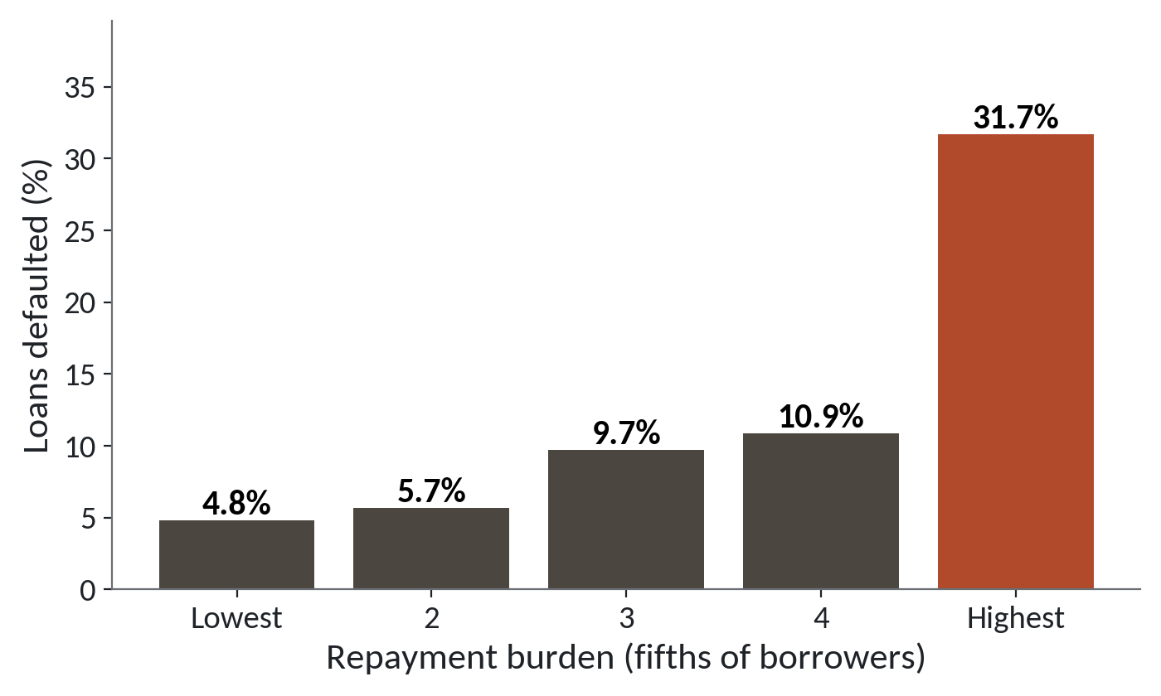
Default climbs with repayment burden
1
The lightest fifth of loans: 4.8 percent defaulted.
2
The middle three fifths climb slowly, to 10.9 percent.
3
The heaviest fifth: 31.7 percent defaulted.
Loans split into five equal groups by burden. About 1,600 loans in each.
Session 15 Classification: yes or no questions
7
Notes:
Before any model, look at the data. Here the loans are sorted into five equal groups by burden, from the lightest to the heaviest.
In the lightest fifth, where the instalment is a small bite of income, four point eight percent of the loans defaulted. About five in a hundred.
The middle three groups climb slowly, from five point seven to ten point nine percent.
Then the heaviest fifth jumps to thirty one point seven percent. That's more than six times the rate of the lightest group.
This jump is the pattern a model has to find.

Slide 8
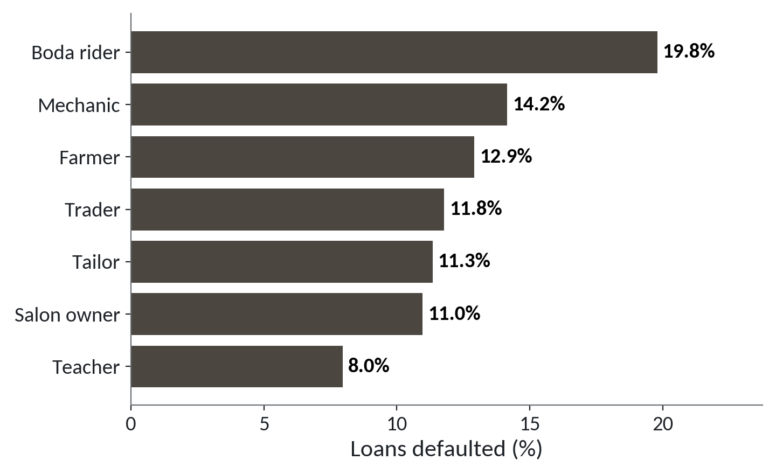
Default rate differs by occupation
1
Boda riders default most: 19.8 percent.
2
Teachers default least: 8.0 percent.
3
The five jobs in between sit from 11.0 to 14.2 percent.
Share of loans that defaulted, for each of the seven occupations.
Session 15 Classification: yes or no questions
8
Notes:
Next, the same question by job. Occupation is text, so a model can't use it yet. First, let's see whether it's worth using.
Boda riders default most, at nineteen point eight percent. That's about one loan in five.
Teachers default least, at eight percent.
The five jobs in between sit from eleven to fourteen percent. So job carries some information, though the gap from top to bottom is smaller than the gap across the burden groups.
We need a way to hand these job names to a model as numbers. We'll do that in a few minutes.

Slide 9
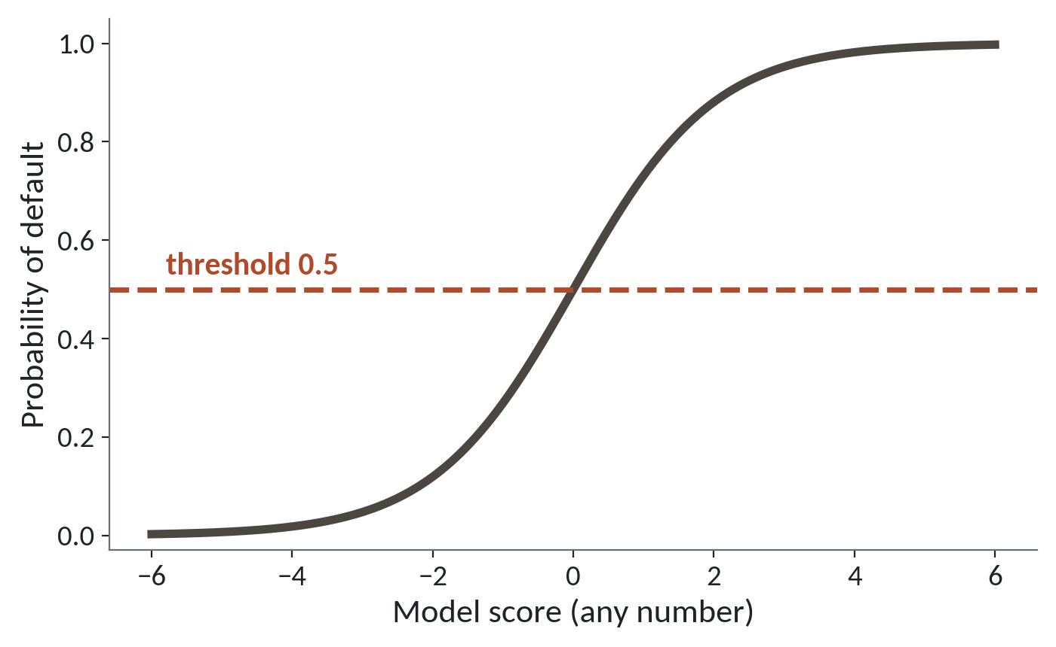
The S curve turns any score into a probability
1
A very low score gives a probability near 0.
2
A very high score gives a probability near 1.
3
The dashed line at 0.5 is the usual cutoff.
A schematic of the sigmoid curve. Scores along the bottom, probability up the side.
Session 15 Classification: yes or no questions
9
Notes:
In Session 13 you drew a straight line to predict a number. Now we predict a chance, and a chance has to stay between zero and one. A straight line has no such limit. It will happily climb past one or sink below zero.
The fix is the curve you see. It's called the sigmoid curve, or the S curve. Whatever score goes in along the bottom, the height of the curve stays between zero and one.
A very low score gives a probability near zero. That loan is very unlikely to default.
A very high score gives a probability near one.
The dashed line at point five is the usual cutoff. A model that builds a score from a line and then bends it with this curve is called logistic regression. In Excel terms, it's a trendline bent so it can never leave the box between zero and one.

Slide 10
Five scores, five probabilities
import numpy as np
scores = np.array([-4, -2, 0, 2, 4])
probs = 1 / (1 + np.exp(-scores))
print(probs.round(3))
1
np.exp does the exponential for all five scores at once.
2
A score of 0 gives exactly 0.5.
Output
[0.018 0.119 0.5 0.881 0.982]
3
A score of 4 gives 0.982. Close to 1, never reaching it.
Session 15 Classification: yes or no questions
10
Notes:
Let's put numbers on the S curve. We make five scores, from minus four to plus four.
The formula is one divided by one plus e to the power of minus the score. You don't need to remember it. Numpy applies it to all five scores at once, like filling a formula down a column.
A score of zero gives exactly point five. The curve crosses its cutoff right there.
A score of four gives point nine eight two. Very likely a default, but never exactly one. The curve flattens near the ends, so even a huge score stays below one.

Slide 11
Text in the inputs stops the model
loans[['age', 'occupation']].astype(float)
1
A model does sums on every input. Mechanic is not a number.
Output
ValueError: could not convert string to float: 'Mechanic'
Session 15 Classification: yes or no questions
11
Notes:
Hand a model a text column and see what happens. We try to turn age and occupation into numbers.
Python stops. The last line says it could not convert string to float, and it names Mechanic, the first value it tried. Read the last line first, as you learned in Session 5.
A model does arithmetic on every input. It can't add Mechanic to forty eight.
The cure keeps occupation in the data, because we've just seen it carries information. We change how we write it down. We'll do that next.

Slide 12
get_dummies gives each category its own column
features = loans.drop(columns=['loan_id', 'disbursed_date', 'district',
'collection_calls', 'default'])
X = pd.get_dummies(features, dtype=int)
print(features.shape, X.shape)
print(X.loc[0, 'occupation_Mechanic'], X.loc[0, 'occupation_Teacher'])
Output
(7998, 14) (7998, 26)
1 0
1
Leave out identifiers, the date, district and collection_calls.
2
Every text column becomes columns of 1 and 0.
3
Loan 0 is a mechanic: a 1 in one column, a 0 in the other.
Session 15 Classification: yes or no questions
12
Notes:
One call makes text usable. In a spreadsheet you would add helper columns. One that holds a one when the borrower is a mechanic and a zero otherwise. Another for teacher, and so on. The name is one hot encoding, and pandas does it in one call, get_dummies.
First we choose what the model may see. We drop the loan number and the date. We drop district, because thirty districts would add thirty columns, so we leave it for later. And we drop collection calls. Those are recorded only after a loan goes bad, so they give away the answer. Session 16 shows what that does to a model.
Then get_dummies turns every text column into zero and one columns. We go from fourteen columns to twenty six. Eleven stay as they were, gender adds two, occupation adds seven, and loan purpose adds six.
Check the first loan. It's a mechanic, so the Mechanic column holds a one and the Teacher column holds a zero. That's the helper column idea exactly.

Slide 13
Fit a logistic regression and ask for probabilities
from sklearn.model_selection import train_test_split
from sklearn.linear_model import LogisticRegression
money = ['monthly_income_ugx', 'loan_amount_ugx', 'savings_balance_ugx']
X[money] = X[money] / 1_000_000
y = loans['default']
X_train, X_test, y_train, y_test = train_test_split(
X, y, test_size=0.25, random_state=42)
model = LogisticRegression(max_iter=1000)
model.fit(X_train, y_train)
p = model.predict_proba(X_test)[:, 1]
1
Money in millions keeps all numbers a similar size. Then split.
2
fit learns from the training loans.
3
predict_proba gives the chance of default for each test loan.
Session 15 Classification: yes or no questions
13
Notes:
Next, the model itself. These are scikit learn lines, so they run in your Colab. Your numbers will come out close to mine, never exactly the same.
First we write the three money columns in millions of shillings. That keeps every number a similar size, so the model settles down quickly. Then we split the loans, seventy five percent to train on and twenty five percent to test on, with a seed so everyone gets the same split.
Next, fit. It's the same call you used last session. The model learns its weights from the training loans.
Last, predict_proba. It returns two columns, the chance of repaid and the chance of default. The bracket at the end keeps the second column. That gives one number per test loan, the predicted probability of default, and those numbers are what we work with from here.

Slide 14
A nested IF and a decision tree ask the same kind of question
Nested IF in Excel
Decision tree
You write every rule yourself
The computer finds the questions
The cutoffs come from your guess
It picks the cutoffs that best split repaid from default
Each IF sits inside the last
You read it as plain rules
Same shape of rule. The tree takes its questions from the loans.
Session 15 Classification: yes or no questions
14
Notes:
The second kind of model has a spreadsheet cousin too. Think of the nested IF formulas you have written. IF the burden is high, check savings, and IF savings are low, flag the loan. Each IF sits inside the last.
On the left, that spreadsheet habit. You write every rule yourself. You choose the cutoffs by guessing, and each IF sits inside the one before.
On the right, a decision tree. The computer finds the questions, and it picks the cutoffs that best separate repaid loans from defaults. You read the result as plain rules.
The verdict says it. The rule has the same shape you already write. The only change is that the questions come from the loans.

Slide 15
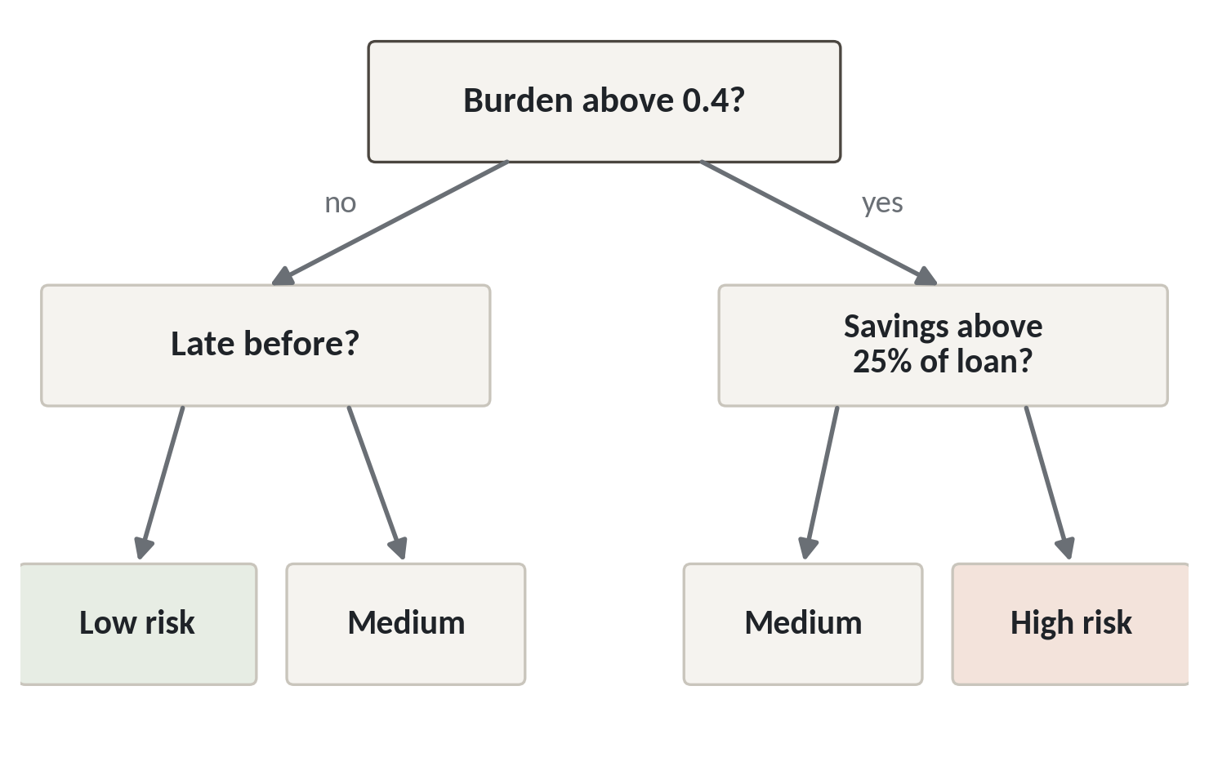
A decision tree is a set of yes or no questions
1
Start at the top question.
2
Each answer sends you down one branch.
3
The box at the bottom is the verdict.
Schematic only. The questions and cutoffs here are illustrative, not fitted to loans.csv.
Session 15 Classification: yes or no questions
15
Notes:
This is what a tree looks like, with one warning. The picture is a schematic. The questions and cutoffs are invented to show the shape. The tree you fit in a minute will have its own.
You always start at the top. The first question is whether the burden is above point four.
Each answer sends you down one branch. A yes goes right, a no goes left, and you meet the next question. That's reading a tree.
The box at the bottom is the verdict. In a real tree each of these boxes also holds a share, the proportion of past loans that ended up there and defaulted. That share is the predicted probability for any new loan that lands in the box.

Slide 16
Fit a small tree and print its rules
from sklearn.tree import DecisionTreeClassifier, export_text
tree = DecisionTreeClassifier(max_depth=3, random_state=42)
tree.fit(X_train, y_train)
print(export_text(tree, feature_names=list(X.columns)))
p_tree = tree.predict_proba(X_test)[:, 1]
1
max_depth=3 allows at most three questions in a row.
2
export_text prints the tree as indented rules.
Session 15 Classification: yes or no questions
16
Notes:
Next we fit a tree to the same training loans. Again this is scikit learn, so run it in Colab. I won't read out numbers, because your tree is yours.
max depth three allows at most three questions in a row. That keeps the tree small enough to read. A tree allowed to keep asking will memorise the training loans, and we'll come back to that in Session 17.
export text prints the tree as indented rules. Each line is a question, and the lines indented under it are the next questions, until you reach a leaf with the verdict. Check which question comes first in your tree. The bar charts we saw suggest repayment burden might lead, but your run decides.
The last line asks the tree for probabilities, just as we did for logistic regression. A tree of depth three has at most eight leaves, so it can only give at most eight different probabilities. That surprises people. In the lab you compare the tree with the logistic regression, by counting how many defaults each one catches at the same threshold.

Slide 17
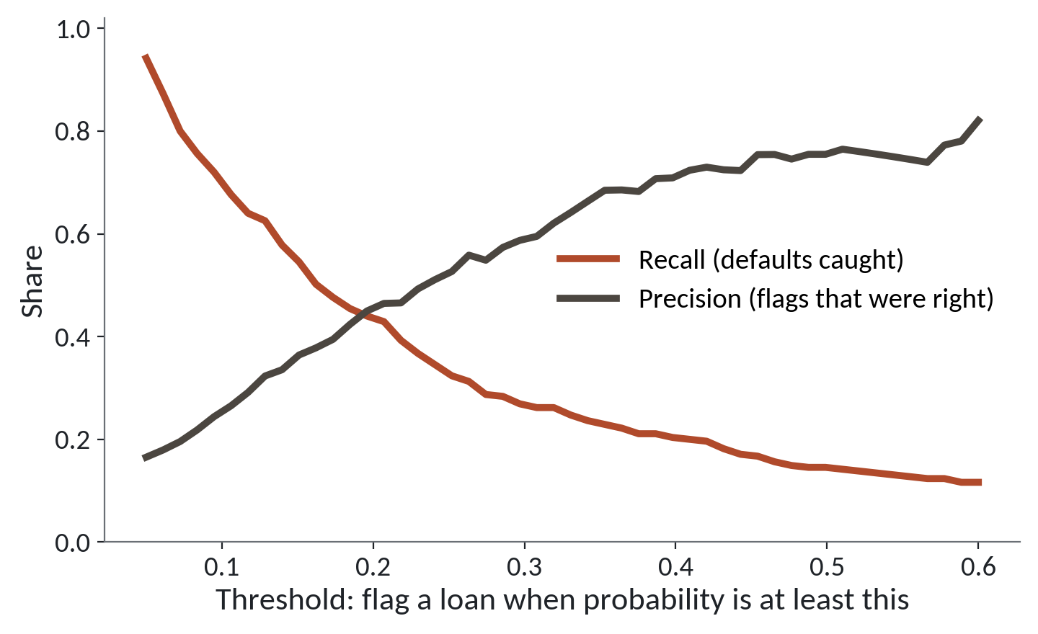
Moving the threshold trades one error for the other
1
Red: the share of defaults caught. It falls as the threshold rises.
2
Blue: the share of flags that were right. It rises.
3
No threshold wins on both lines.
A logistic regression on 2,000 test loans. Your scikit-learn run will be close but not identical.
Session 15 Classification: yes or no questions
17
Notes:
Back to the threshold. Remember, it's the probability at or above which we say yes and flag the loan. In Excel, it's the cutoff in an IF formula on a score column.
The red line shows the share of defaults we catch. At a low threshold we flag many loans and catch most defaults. As the threshold rises, we flag fewer, and the red line falls. At the usual point five, this model catches only about one default in seven.
The blue line shows how often a flag turns out right. It does the opposite and rises.
So no threshold wins on both lines. Sliding it only trades one kind of mistake for the other. Which trade is best depends on what each mistake costs, and we'll price them next.

Slide 18
What four thresholds cost, with teaching prices
Threshold | Defaults missed | Good loans refused | Missed x 1,000,000 | Refused x 100,000 | Total cost
0.5 | 235 | 13 | 235.0 million | 1.3 million | 236.3 million
0.3 | 202 | 52 | 202.0 million | 5.2 million | 207.2 million
0.2 | 155 | 142 | 155.0 million | 14.2 million | 169.2 million
0.15 | 124 | 268 | 124.0 million | 26.8 million | 150.8 million
Invented teaching costs in UGX: a missed default loses 1,000,000 of principal. A refused good loan loses 100,000 of interest. Counts are from 2,000 test loans, 275 of them defaults.
Session 15 Classification: yes or no questions
18
Notes:
Let's price the mistakes. These costs are invented for teaching, so don't quote them outside this room. A missed default loses one million shillings of principal. A good loan we refuse loses one hundred thousand shillings of interest we would have earned.
The counts come from our logistic regression on two thousand test loans, of which two hundred and seventy five defaulted. Take the first row, threshold point five. We missed two hundred and thirty five defaults, and that costs two hundred and thirty five million. We refused thirteen good loans, which costs one point three million. The total is two hundred and thirty six point three million.
Do the rest in your head or with a calculator. The total falls row by row. At point one five, we miss only one hundred and twenty four defaults. We refuse two hundred and sixty eight good loans, but each of those costs a tenth as much. The total is one hundred and fifty point eight million, the cheapest of the four.
A missed default costs ten times a refused loan, so it pays to flag many more loans than the default threshold flags.

Slide 19
The same sum in NumPy
import numpy as np
thresholds = np.array([0.5, 0.3, 0.2, 0.15])
missed = np.array([235, 202, 155, 124])
refused = np.array([13, 52, 142, 268])
cost = missed * 1_000_000 + refused * 100_000
print(cost)
print(thresholds[cost.argmin()])
1
Multiply each count by its price and add. One line, four answers.
2
argmin gives the position of the smallest cost.
Output
[236300000 207200000 169200000 150800000]
0.15
Session 15 Classification: yes or no questions
19
Notes:
The table is a spreadsheet job, and NumPy does it in one line. It's the same job as SUMPRODUCT in Excel.
We store the counts as arrays. The cost line multiplies every missed default by a million and every refused loan by a hundred thousand, then adds them up. One line gives all four totals, and they match the table.
argmin finds the position of the smallest cost. We use it to look up the threshold in that position, and it gives point one five. In the lab you'll do the same on a small array of your own.
One warning. That is the cheapest of the four thresholds we tried. A different threshold could be cheaper still, so in practice you try many.

Slide 20
The default cutoff of 0.5 can fit the wrong business
What it looks like
Why it goes wrong
The fix
You call predict. It gives yes or no answers, and about 88 loans in 100 are called correctly. It runs with no error and the score looks good.
Only 12.5 percent of loans default, so almost no loan reaches 0.5. Saying no to everyone also scores about 86 in 100 on these test loans. At 0.5 the model catches about 40 of 275 defaults.
Ask for probabilities. Choose the threshold from the cost of each mistake. Report defaults caught beside the score.
Session 15 Classification: yes or no questions
20
Notes:
Today's trap gives no error at all.
You call predict, the model gives yes or no answers, and about eighty eight loans in a hundred are called correctly. That sounds good. Nothing warns you.
The problem is that only twelve and a half percent of loans default. Very few loans reach a probability of point five. A model that said no to every loan would also score about eighty six in a hundred on these test loans, which hold a few more defaults than the average. At point five, our model catches about forty of the two hundred and seventy five defaults in the test loans.
The fix has three parts. Ask the model for probabilities instead of yes and no. Choose the threshold from what each mistake costs. And always report the defaults you caught next to the headline score.

Slide 21
Lab: encode, fit and price the mistakes
1
Open the Session 15 notebook and run setup
Tool and time
Google Colab
40 minutes
2
Load the loans and build the burden column
3
Encode the text columns with get_dummies
You are done when
4
Fit a logistic regression and a small tree
Both models fit, and you can say why your threshold is below 0.5.
5
Count the defaults each model catches
6
Find the occupation with the highest default rate
7
Choose a threshold by the cost of each mistake
Session 15 Classification: yes or no questions
21
Notes:
The first task prepares the loans, the same three steps as the live part: keep ages from eighteen to eighty, fill the missing incomes, and add the burden column. Run the setup cell in the Session 15 notebook before it. Task two is the encoding, and you'll see the column count change.
Tasks three and four fit the two models. Those use scikit learn, so your numbers will be near mine but will differ a little, and the checks allow for that. Task five compares them. At a threshold of point two, you count how many defaults each one catches and how many loans it flags to do it.
Then comes the occupation question, and the last coding task is the one that matters most. You price each mistake and pick the cheapest threshold on a small set of loans. You have forty minutes, and I'm around if an error stops you.

Slide 22
Questions to finish
1
A logistic regression gives 0.3 for a loan. What does that mean, and what do you do with it?
A 30 percent chance of default. You compare it with your threshold to decide yes or no.
2
Why does a model need get_dummies for the occupation column?
A model does sums on numbers. get_dummies gives each job its own column of 1 and 0.
3
A missed default costs ten times a refused good loan. Should your threshold sit above or below 0.5?
Below. Flagging more loans costs less than missing defaults.
Session 15 Classification: yes or no questions
22
Notes:
This set starts with a probability of point three, so keep the threshold in mind. Answer each in your head before I give mine.
Question one. A logistic regression gives point three for a loan. What does that mean, and what do you do with it? Take your time.
It means a thirty percent chance of default. You compare it with your threshold, and at or above the threshold you say yes.
Question two. Why does a model need get dummies for the occupation column? Think it over.
A model does sums on numbers, and Mechanic is not a number. get dummies gives each job its own column of ones and zeros.
Question three. A missed default costs ten times a refused good loan. Should your threshold sit above or below point five? Give that a moment.
Below. Flagging more loans costs less than missing defaults. In the table the cheapest row was the lowest threshold.

Slide 23
Summary
Classification gives a probability. A threshold turns it into yes or no.
Models need numbers. get_dummies gives every category its own 1 and 0 column.
Choose the threshold from what each mistake costs.
Next session. Judging a model: metrics, leakage and imbalance
Session 15 Classification: yes or no questions
23
Notes:
One. A classification model gives a probability for every loan. A threshold that you choose turns it into yes or no.
Two. A model needs numbers, so every category gets its own column of ones and zeros with get dummies.
Three. Pick the threshold from what each mistake costs. The default point five suits nobody in particular.
Next session we ask how to tell a model that works from one that only looks good. We'll meet the confusion matrix, find the column that leaks the answer, and learn why accuracy can mislead. Bring your Session 15 notebook.

